Slide 1
Swan’s Ride Data (as of 11 Nov 22)

Slide 2
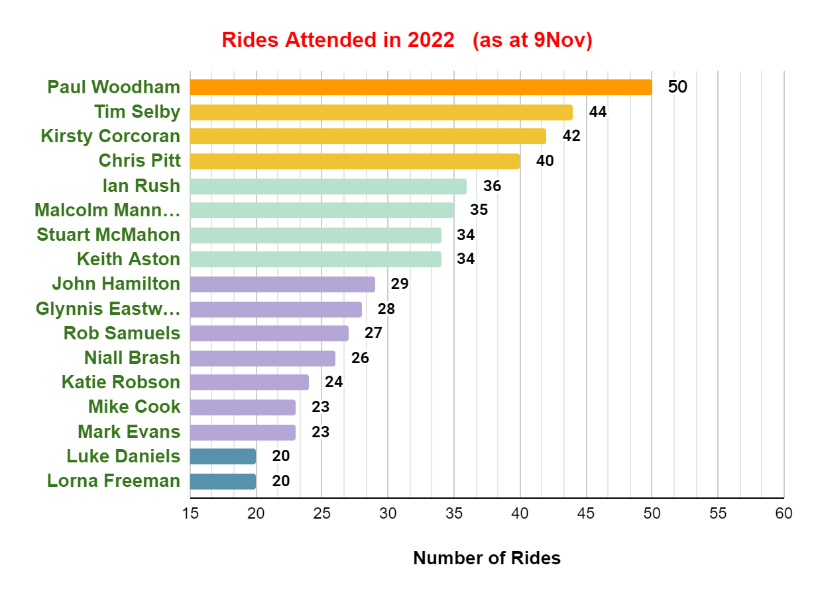
Swan’s Ride Attended Data

Slide 3
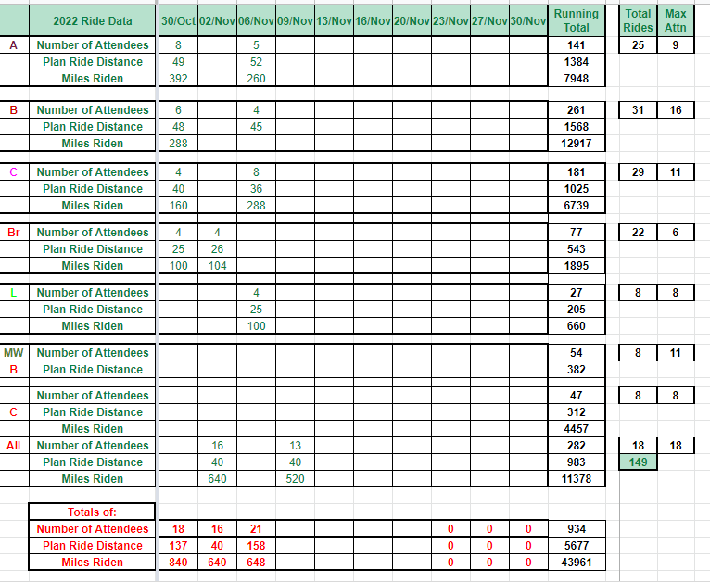
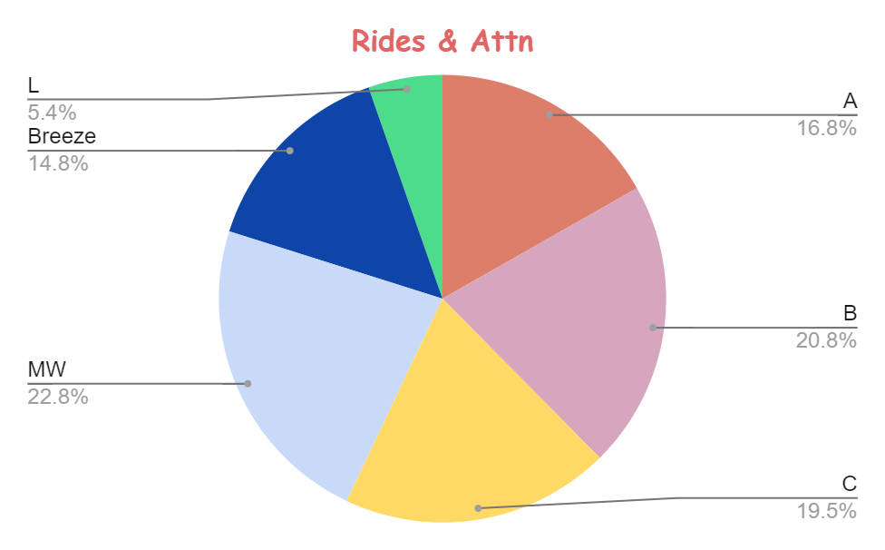
Swan’s Ride Data / Groups

Slide 4
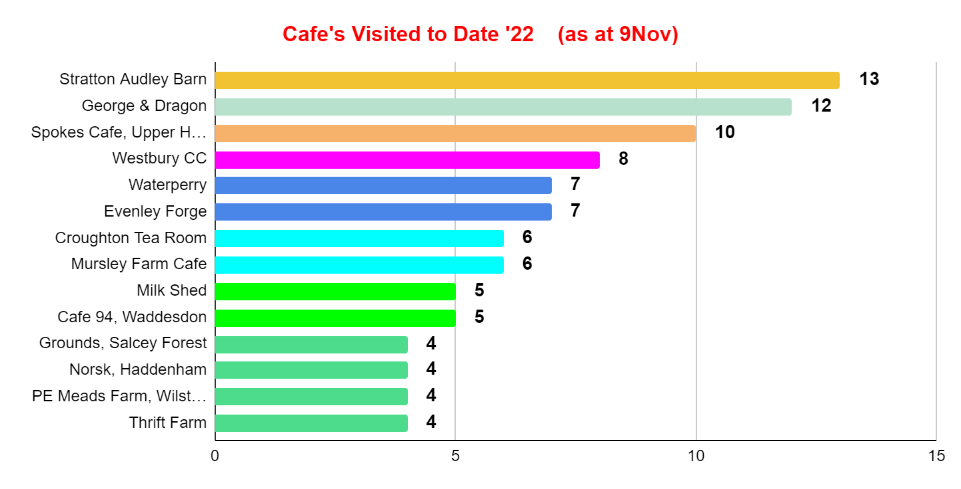
Swan’s Cafe Data

Slide 5
Swan’s Membership Data

Slide 6
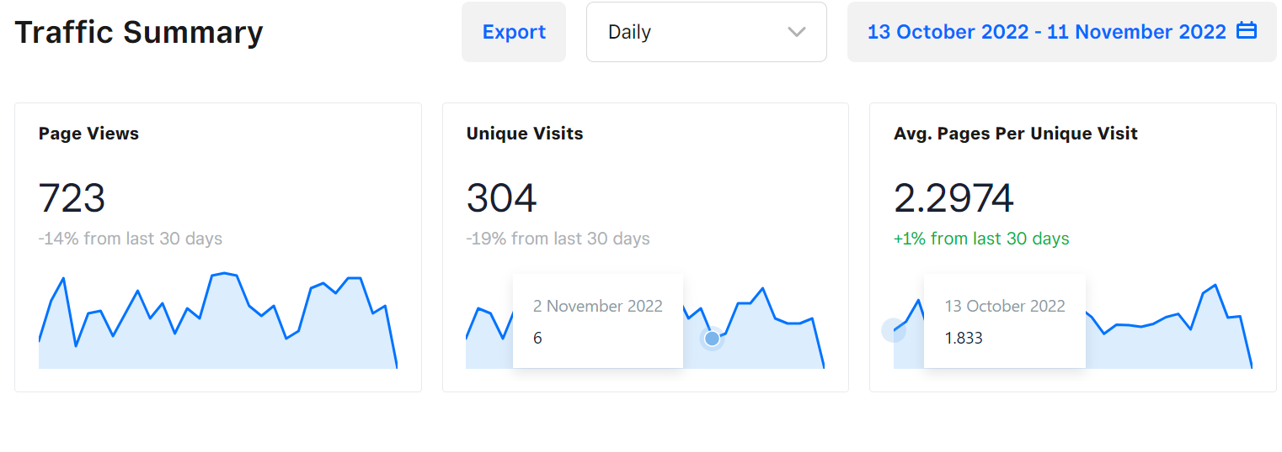
Swan’s Website Traffic

