Slide 1
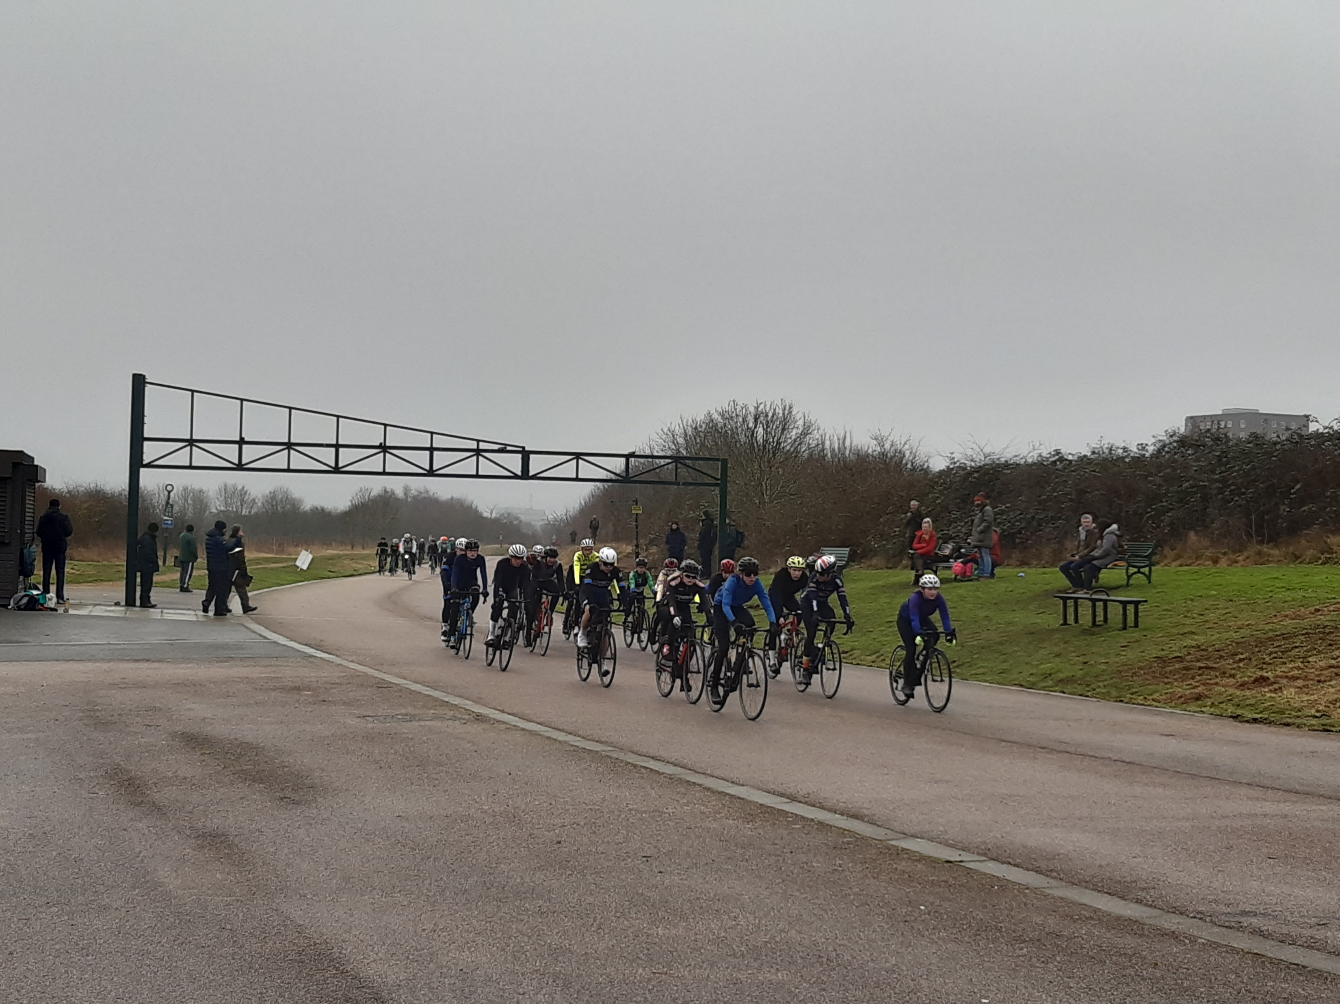
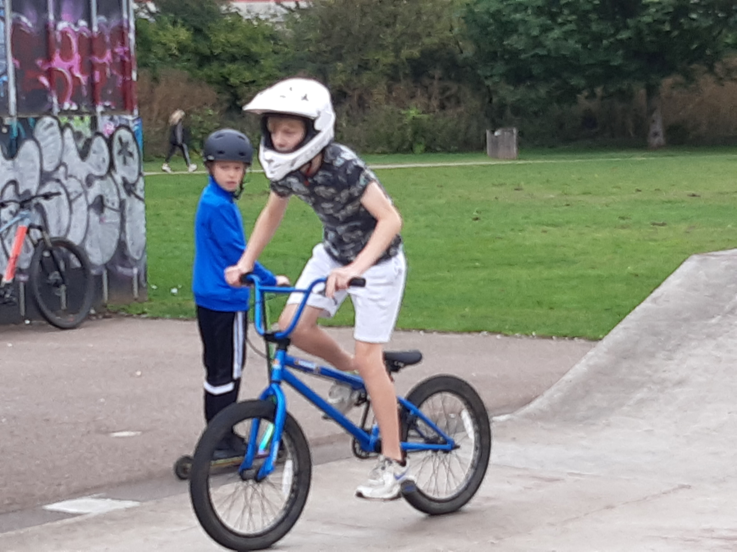
Club News January 2023
Promote your club - run an event (britishcycling.org.uk)
For a MTB Gravity Trainee Commissaires course which covers downhill and 4X use this link
Use all these different links to find out more
Let's Ride - Community Groups (letsride.co.uk)
You are invited to a Clubs Development Zoom meeting on the 16th of February at 8pm to share ideas and discuss development opportunities.
Join Zoom Meeting
Use this Link to register
It will be great to find out what’s happening and meet more members ☺
Have a go at any of the different Club Workshops that Club Matters are offering to help and your club E.G., Dealing with Increasing Costs, Engaging with your Community etc
Club Matters Workshops (sportenglandclubmatters.com)
Upcoming recreation Events in Central - British Cycling
Central Talent Development Events - British Cycling
email me with questions, ideas, requests … catherineruffley@britishcycling.org.uk

Slide 2
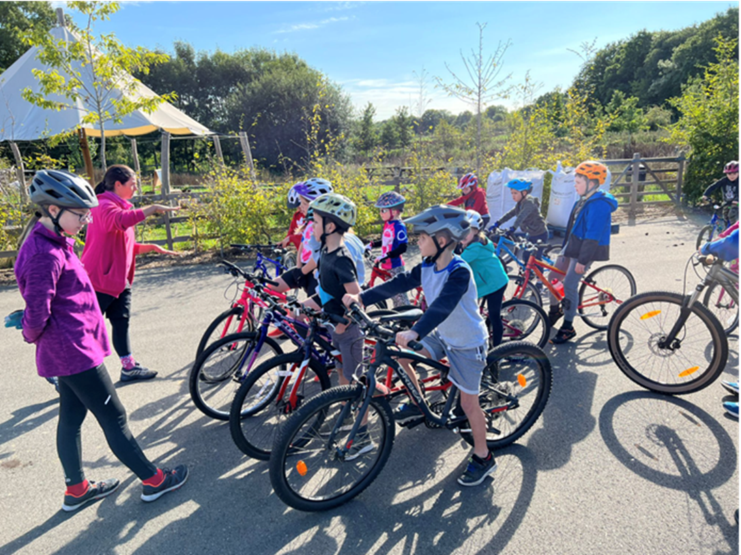
Central Region Volunteer of the Month
Izzy has always been super helpful even being a Young Volunteer and she has blossomed since. Her coaching skills are shaping incredibly well, she’s super patient and has a lot of knowledge to share about cycling techniques which she does in such bubbly positive way! The last time I worked with her coaching our youngest riders I was thoroughly impressed with how she used her initiative and adapted the session to suit the riders and crowd control.
Last month she completed the training and is now one of our Level 1 Coaches.
The picture shows Izzy and Claire coaching Sprockets Rascals (6-8yrs)
Nominate the next Central Volunteer of the month. Somebody from your club/group
Please send me some photos of the volunteers that you wish to nominate with a descriptions of the great activities they do so we can tell everyone. catherinrruffley@britishcycling.org.uk

Slide 3
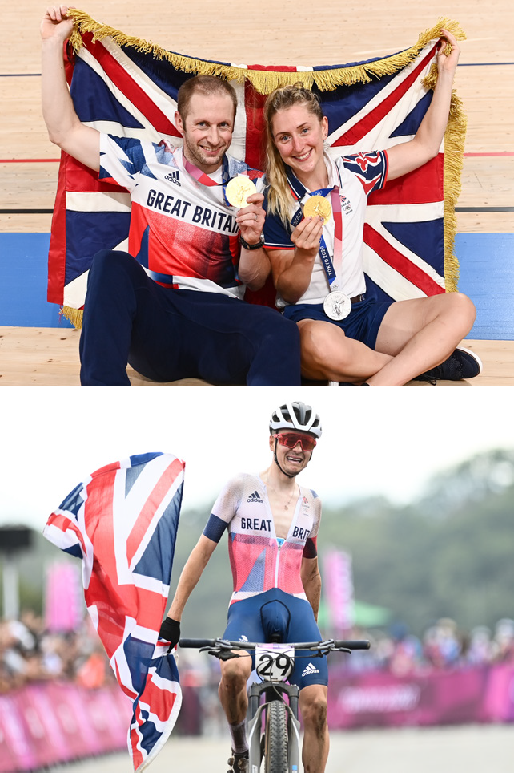
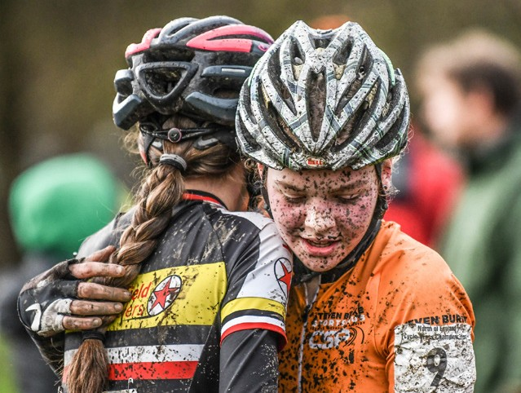
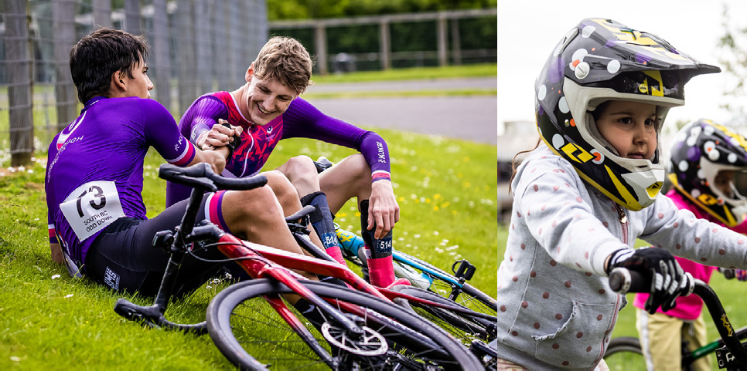
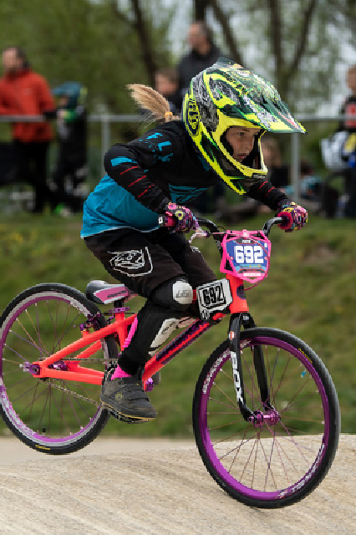
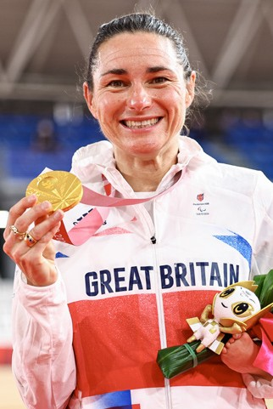
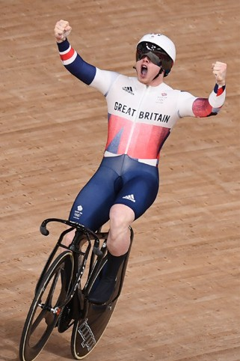
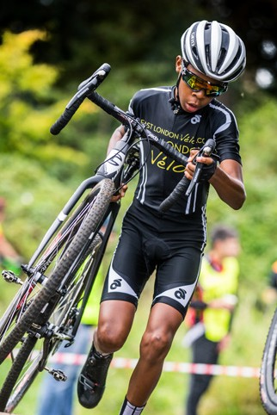
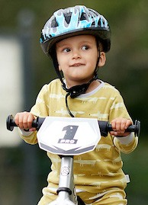
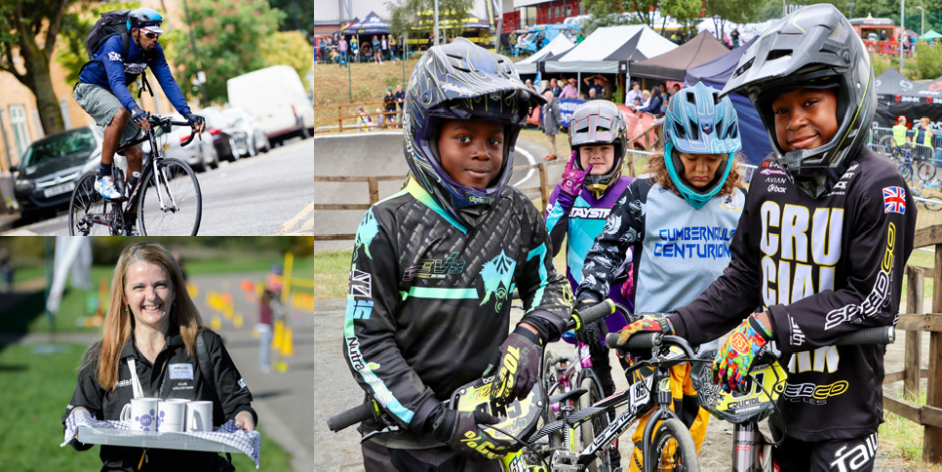
Central Event News Racing at Dalton Barracks is back for 2023 with ART Winter Crit Series 2023 Use this link for more details of the first event in the series The winter circuit series at Hillingdon Use this link for the first event in February Pre entering events helps the event organisers and stop events being cancelled https://bit.ly/3wYTpLH
If you are a coach that would be interested in delivering coaching at these events please email catherineruffley@britishcycling.org.uk
Upcoming Central Road Events - British Cycling

