Slide 1
SWCC Ride Data
RIDE DATA UPDATE: APRIL – AUGUST 2021

Slide 2
SWCC RIDE DATA: APRIL-AUGUST 2021
RIDERS – 77
RIDES – 87
RIDERS – 823
MILES – 4048
CAFES - 37

Slide 3
SWCC RIDE DATA: APRIL-AUGUST 2021
 | RIDES | RIDERS | MILES
A | 19 | 94 | 1111
B | 21 | 214 | 1116
C | 21 | 223 | 778
L | 6 | 28 | 147
MW | 20 | 253 | 896
TOTAL | 87 | 803 | 4048

Slide 4
A few new faces leading rides….
Glynnis
David B
Lizzie T
Stuart Mc

Slide 5
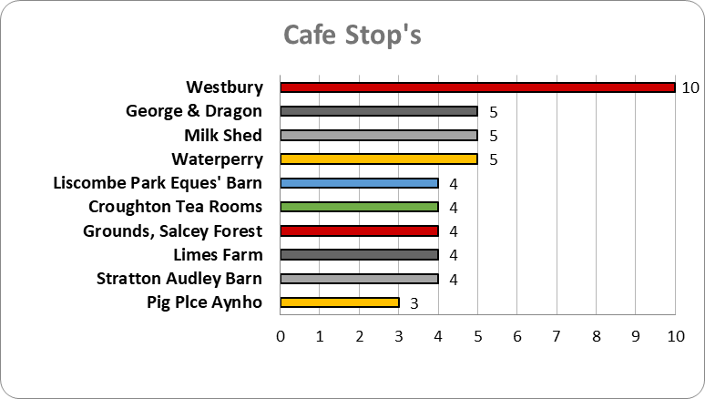

Slide 6
